Slide 1

Accident Severity Prediction
Elahe Talaie
October 2020

Slide 2
Introduction
There were 1.35 million road traffic deaths globally in 2016, according to WHO.
Understanding the most relevant factors contributing to road accidents is critical to improve road safety and save lives.
Accident analysis and prediction is a significant field of research considering its impact on public safety.

Slide 3
Objective: To Predict Accident Severity
Input
Output
Accident conditions
such as:
Collision type
Junction type (if applicable)
Road conditions
Weather conditions
Light conditions
Speeding
Influence of drugs or alcohol
If pedestrians or bicycles involved
Code 1
(Property damage)
Process
Classification
Algorithms
Code 2
(Injuries)

Slide 4
Data and Methods
Data Source: the Seattle Department of Transportation (SDOT) Traffic Management Division, Traffic Records Group
194673 rows and 38 columns
Target column: Severity Code (Code 1 and Code 2)
One-Hot Encoding to convert categorical variables to binary variables
70% of data with Severity Code 1
Negative sampling for data balancing
Classification Algorithms: K-Nearest Neighbors (KNN), Decision Tree (DT), Support Machine Vector (SVM), and Logistic Regression (LR)

Slide 5
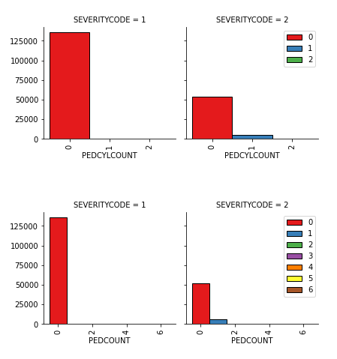
Data Exploring
When pedestrians or bicycles were involved in the accident, the ratio of the accidents with injuries was increased.

Slide 6
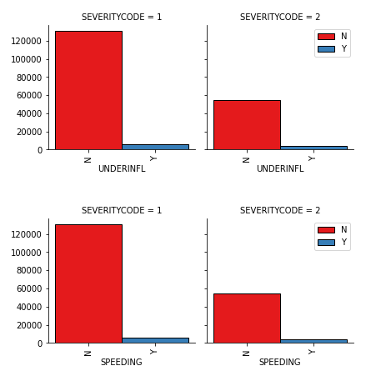
Data Exploring
When the driver was under the influence of drugs or alcohol, or when speeding was a factor in the accident, the ratio of the accidents with injuries was increased.

Slide 7
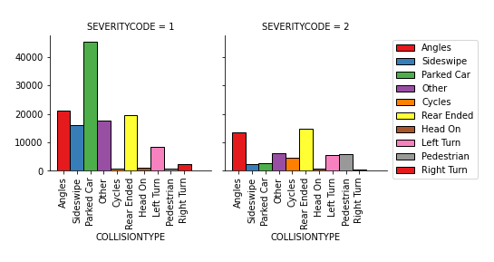
Data Exploring
Collision type was an significant factor affecting the severity of an accident.

Slide 8
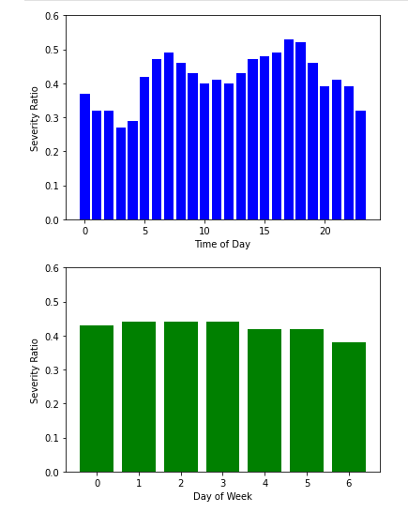
Data Exploring
The severity ratio (defined here as the number of accidents with injuries over the number of accidents with property damage) was higher during rush hours, but almost the same over different days of the week.

Slide 9
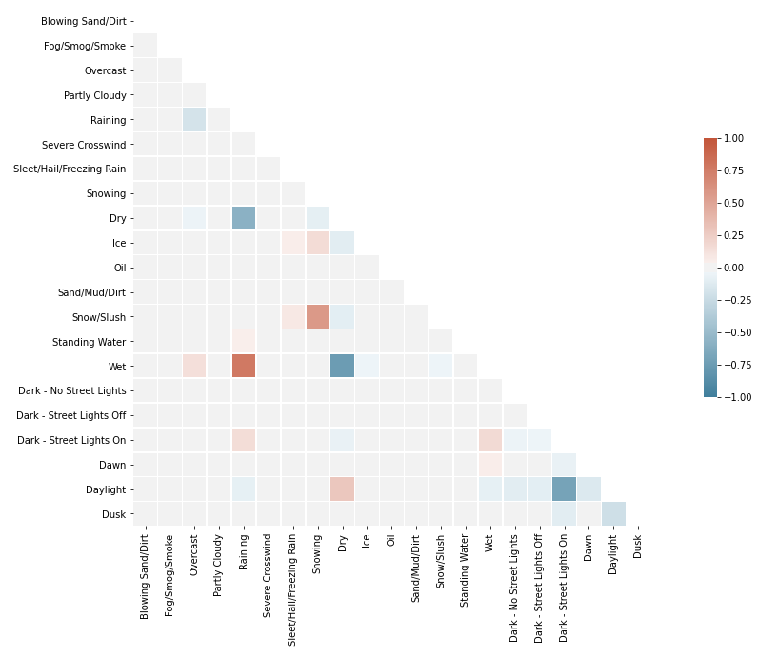
Data Exploring
Heatmap showed that some features had strong correlations. Some of them were dropped from the feature set.

Slide 10
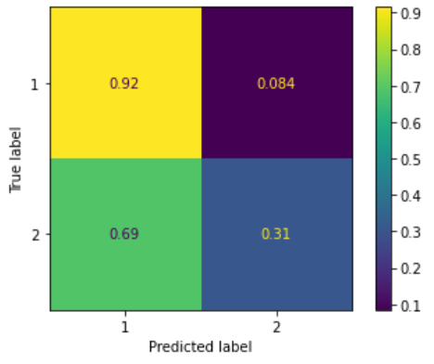
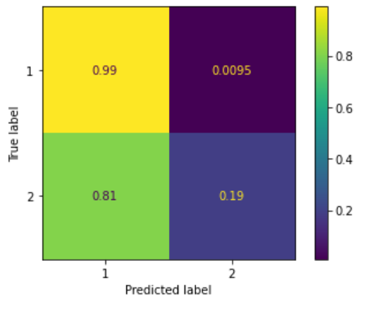
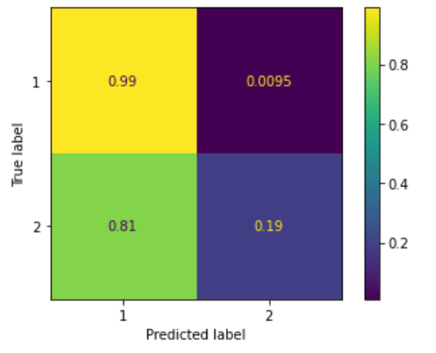
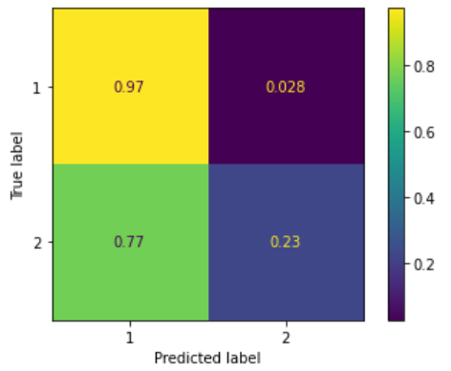
Confusion Matrix (normalized to true test values)
KNN
SVM
The classifiers were trained on imbalanced (original) test set.
DT
LR

Slide 11
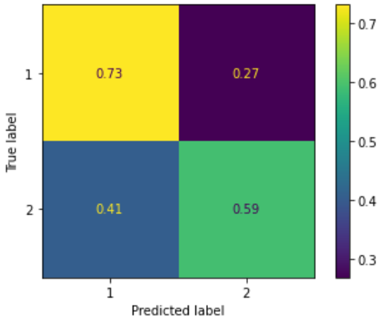
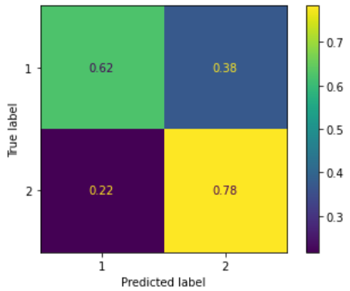
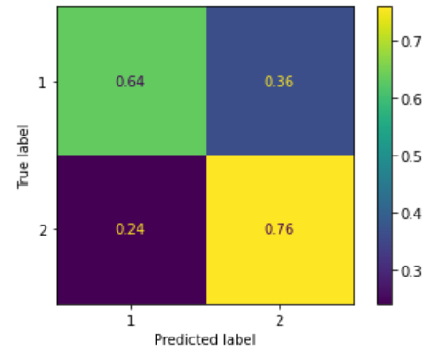
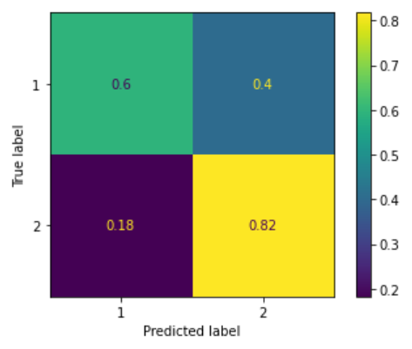
Confusion Matrix (normalized to true test values)
KNN
SVM
The classifiers were trained on balanced test set.
DT
LR

Slide 12
F1-Scores
 | KNN |  |  | SVM |  |  | DT |  |  | LR
 | Code 1 | Code 2 | W-Avg | Code 1 | Code 2 | W-Avg | Code 1 | Code 2 | W-Avg | Code 1 | Code 2 | W-Avg
Trained on Original Training Set | 0.83 | 0.41 | 0.70 | 0.85 | 0.31 | 0.69 | 0.85 | 0.31 | 0.69 | 0.84 | 0.36 | 0.70
Trained on Balanced Training Set | 0.77 | 0.53 | 0.70 | 0.73 | 0.59 | 0.69 | 0.73 | 0.58 | 0.69 | 0.72 | 0.59 | 0.68

Slide 13
Conclusions
When the classifiers were trained on the imbalanced training test, their performances on the prediction of the majority class (Code 1) were excellent; the support vector machine and decision tree algorithms classified 99% of the majority class instances into the correct one. However, the performances of all four classifiers were poor predicting the minority class
When trained on the balanced training set, their performance on predicting the minority class improved significantly, but their scores on the majority class were decreased.

